Slide 1
S.Sc Activity
The Constitution safeguards the interest of every citizen

Slide 2
The true measure of greatness of a country is analysed through the effective implementation of the right of its citizens. Every country awards certain rights (with limitation) to its citizens. A healthy administration is the one who that provides absolute rights and freedom to its people, and India is one of such country in the world.
These rights are written in the constitution and it is the responsibility of the existing government to protect these rights. The legislature, the executive and the judiciary safeguard these rights. They give justice to the one whose rights are violated.

Slide 3
Fundamental Rights
Fundamental Rights are essential human rights that are offered to every citizens irrespective of there caste, race, creed, place of birth, religion or gender. These are equal to freedom and these rights are essential for personal good and society at large.
There are six fundamental rights, they are:-
The right to EQUALITY.
The right to FREEDOM.
The right to Freedom from EXPLOITATION.
The right to FREEDOM of RELIGION.
CULTURAL and EDUCATIONAL rights.
The right to CONSTITUTIONAL REMEDIES.

Slide 4

RIGHT TO EQUALITY

Slide 5
RIGHT TO EQUALITY
Equality before law:- Article 14 of the constitution guarantees that all citizens shall be equally protected by the laws of the country.
Social equality and equal access to public areas:- Article 15 of the constitution states that no person shall be discriminated on the basis of caste, colour, language etc. Every person shall have equal access to public places like public parks, museums, wells, bathing ghats and temples etc. However, the State may make any special provision for women and children.

Slide 6
RIGHT TO EQUALITY
Equality in matters of public employment:- Article 16 of the constitution lays down that the state cannot discriminate against anyone in the matters of employment. All citizens can apply for government jobs.
Abolition of untouchability:- Article 17 of the constitution abolishes the practice of untouchability. Practice of untouchability is an offence and anyone doing so is punishable by law.
Abolition of titles:- Article 18 of the constitution prohibits the State from conferring any titles. Citizens of India cannot accept titles from a foreign State.

Slide 7
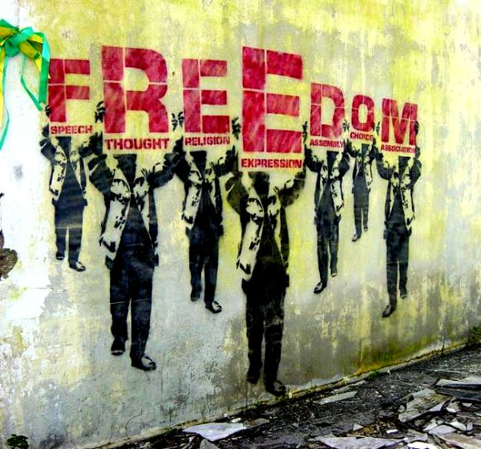
RIGHT TO FREEDOM
This Photo by Unknown Author is licensed under CC BY

Slide 8
RIGHT TO FREEDOM
Freedom of speech and expression:- It enables an individual to participate in public activities. The phrase, “freedom of press” has not been used in Article 19, but freedom of expression includes freedom of press.
Assembly in a peaceful manner:- Citizens have the freedom to hold meetings, processions, rallies and demonstrations on any issue. They may want to discuss a problem, exchange ideas, mobilise votes for a candidates or party in an election. But such meetings have to be peaceful. They should not lead to public disorder or breach of peace in society. Those who are participating in these meetings should not carry weapons.

Slide 9
RIGHT TO FREEDOM
Move freely throughout the country:- As a citizens we have the freedom to move freely in any part of country. This freedom also provide the freedom to choose occupation. No one have the right to force you to choose a certain job. Women cannot be told that some of the occupations are not for them.
The Constitution says that no person can be deprived of his life personal liberty except according to procedure established by law. It means that no person can be killed unless the has ordered a death sentence. It also means that a government or police officer cannot arrest or detain any citizen unless he has proper legal justification.

Slide 10
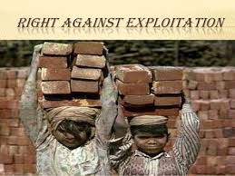
RIGHT AGAINST EXPLOITATION

Slide 11
RIGHT AGAINST EXPLOITATION
The makers of constitution thought it is was necessary to write down certain clear provisions to prevent exploitation of the weaker sections of the society. The constitution mentions three specific evils and declare these illegal.
First, the constitution prohibits ‘traffic in human beings’. Traffic here means selling and buying of humans, usually women, for immoral purposes.
Second, Constitution also prohibits forced labour or begar in any form.
Finally, the constitution also prohibits child labour. No one can employ a child below fourteen to work in factories or mines.

Slide 12

RIGHT TO FREEDOM OF RELIGION

Slide 13
RIGHT TO FREEDOM OF RELIGION
According to the constitution, all religions are equal before the state and no religion shall be give given preference over the other. Citizens are free to preach, practice and propagate any religion of their choice.
Religious communities can setup charitable institutions of their own.
Activities in such institutions which are not religious are performed according to the laws laid down by the government.
No person shall be compelled to pay taxes for the promotion of a particular religion.
A State run institution cannot impart education that is pro-religion.

Slide 14

CULTURAL AND EDUCATIONAL RIGHTS

Slide 15
CULTURAL AND EDUCATIONAL RIGHTS
Any community which has a language and a script of its own has the right to conserve and develop it.
All minorities, religious or linguistic, can set up their own educational institutions to preserve and develop their own culture

Slide 16
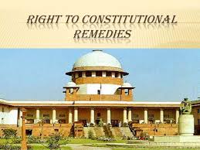
RIGHT TO CONSTITUTIONAL REMEDIES

Slide 17
RIGHT TO CONSTITUTIONAL REMEDIES
Right to constitutional remedies empowers the citizens to move a court of law in case of any denial of the fundamental rights.
This procedure of asking the courts to preserve or safeguards the citizens’ fundamental rights can be done in various ways. The courts can issue various kinds of writs. These writs are habeas corpus, mandamus, prohibition, quo warranto and certiorari.

